Slide 1

Project Title -SEASONAL AGRICULTURE PERFORMANCE ANALYSIS
NAME - DEEPANSHI AGARWAL
College Name- MANIPAL UNIVERSITY JAIPUR
AICTE Internship Student Registration ID: STU6a68a895919291785243797
Student ID Enrolment number : 261450116048

Slide 2

PROBLEM STATEMENT
Agricultural activities are influenced by seasonal variations in environmental conditions, farming practices, resource availability and market conditions. As a result, agricultural performance may differ from one season to another. However, raw agricultural data does not clearly explain how agricultural performance changes across seasons or what patterns can be observed in different seasonal conditions. The problem is to analyze the given agricultural dataset and investigate seasonal differences in agricultural performance by identifying meaningful patterns, trends, relationships and variations within the available data.

Slide 3
Project Description This project analyzes agricultural data across Kharif, Rabi and Zaid seasons to identify seasonal patterns and differences in agricultural performance. The analysis covers: Crop yield and production Environmental conditions Agricultural resource usage Irrigation methods Water efficiency Revenue, cost and profit Crop-wise seasonal performance Relationships between agricultural variables Python-based data cleaning, exploratory data analysis, statistical analysis and visualization.

Slide 4

WHO ARE THE END USERS?
Farmers
Understand seasonal crop performance
Improve resource planning
Support irrigation and crop planning
Agricultural Planners
Compare agricultural performance across seasons
Support evidence-based seasonal planning
Agricultural Researchers
Study seasonal patterns
Analyze environmental and agricultural relationships
Government / Agricultural Departments
Support agricultural planning
Identify areas requiring further investigation

Slide 5

Technology Used
Programming Language
Python
Platform
Google Colab / Jupyter Notebook
Libraries
Pandas
NumPy
Matplotlib
Seaborn
Version Control
GitHub
Techniques
Data Cleaning
Exploratory Data Analysis
Statistical Analysis
Data Visualization
Correlation Analysis

Slide 6
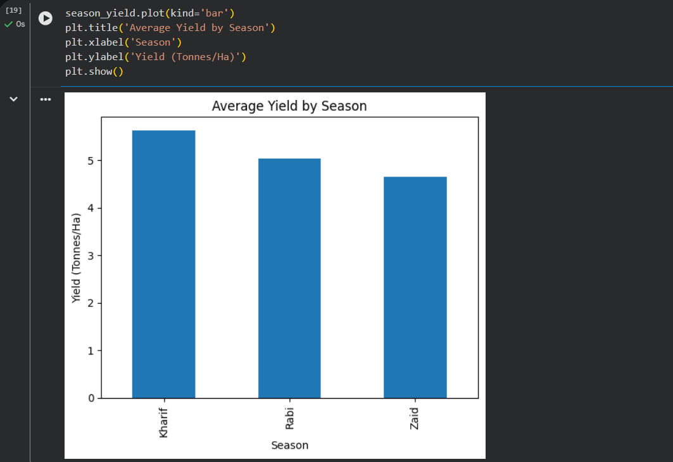
RESULTS
The analysis of 4,000 agricultural observations across Kharif, Rabi and Zaid seasons revealed clear seasonal differences in agricultural performance. Differences were observed in yield, production, economic performance, environmental conditions, resource usage and water efficiency. Kharif showed the strongest overall performance in terms of average yield, production and profit, while Zaid showed comparatively lower yield and production and a negative average profit. Crop-wise analysis also showed variations in yield across seasons.

Slide 7
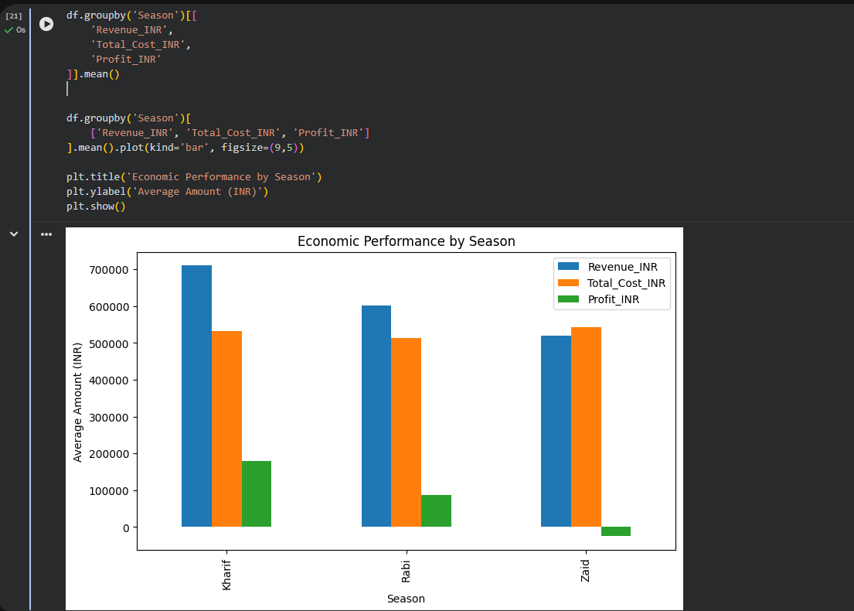
RESULTS
Production and Economic Performance-

Slide 8
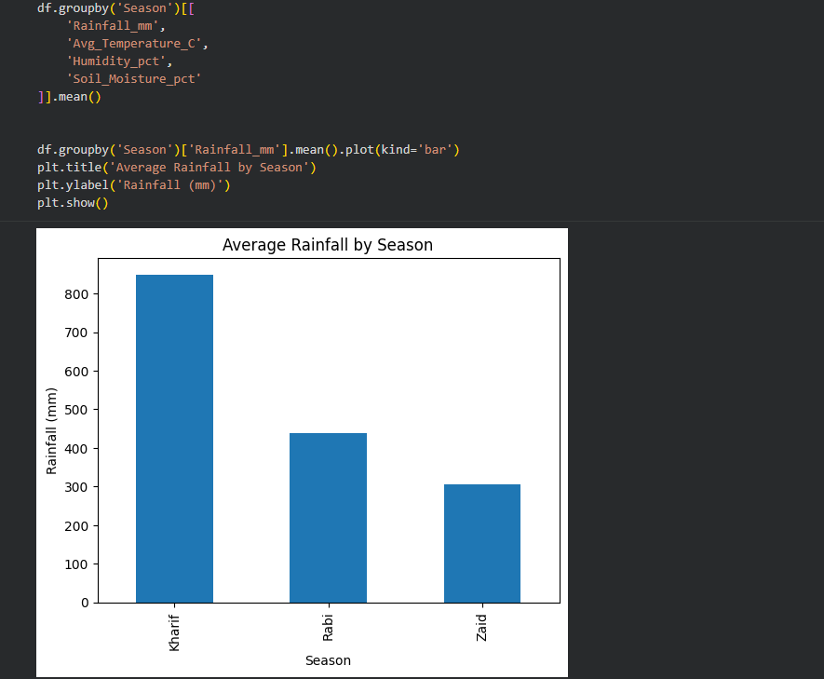
RESULTS
Environmental Conditions

Slide 9
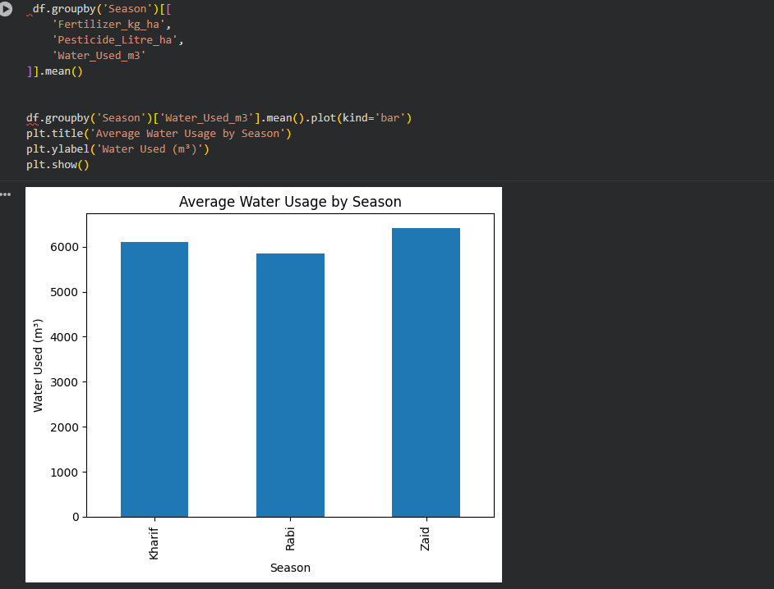
RESULTS
Resource Usage & Water Efficiency

Slide 10
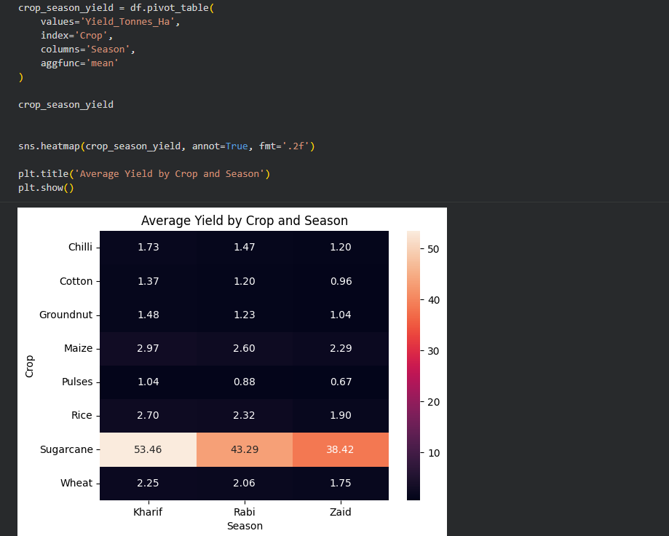
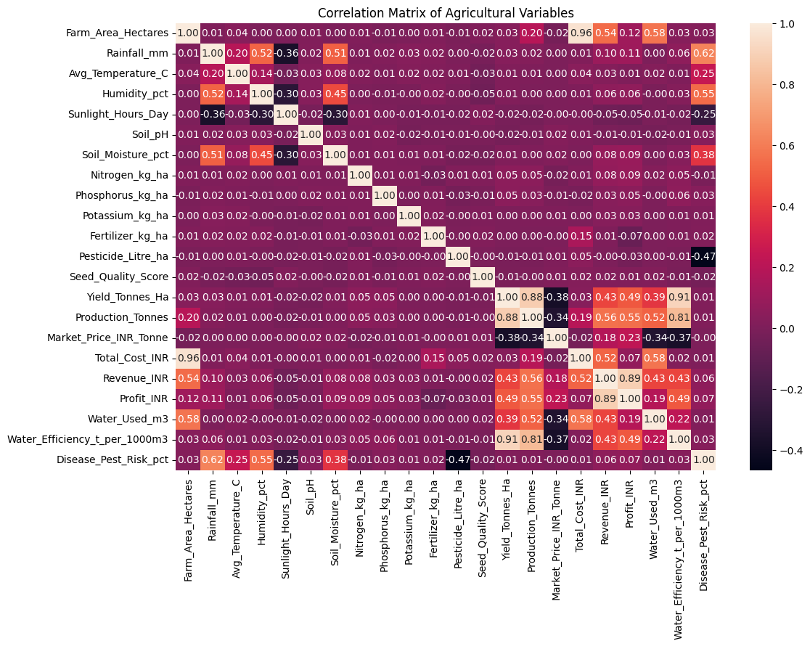
RESULTS
CROP WISE SEASONAL PERFORMANCE & CORRELATION

Slide 11
Future scope
Incorporate multi-year historical agricultural data.
Include real-time weather and environmental data.
Develop machine-learning models for crop-yield prediction.
Forecast seasonal profitability and production.
Develop an interactive agricultural dashboard.
Expand analysis to more crops and geographical regions.
Incorporate satellite and remote-sensing data.
Develop early-warning systems for disease and pest risks.

Slide 12
GitHub Link
https://github.com/deepanshiagarwal580/Seasonal-Agriculture-performance-analysis.git

Slide 13

VOIS Course completion certificate - Course name- Data Visualization

Slide 14
Thank you
.
.
PRESENTER - DEEPANSHI

